Slide 1
ENTREPRENEURSHIP

Slide 2
Topic: Entrepreneurship
Lesson Objective: To understand the meaning of entrepreneurship and innovation. How do entrepreneurs differ from other people who own/run a business?
Do Now: Silently read pages 398-399 (Oxford Year 7) and answer questions 1, 2, 3, 4 in your book.
Agenda: 1. Do Now 2. Some examples of Entrepreneurs 3. Frayer model | Vocabulary: Entrepreneur Innovation Characteristics
I have been successful in this lesson if I am able to complete the Frayer model diagram with a definition, characteristics, examples and non-examples

Slide 3
DO NOW:
Silently read pages 398-399 of the Oxford Year 7 Textbook and answer questions 1, 2, 3, 4 in your book.

Slide 4
DO NOW
Make as many words out of the following word:
ENTPRENEURSHIP

Slide 5
SEINFELD
https://www.youtube.com/watch?v=mkvbZ-e795k
Parks and recreation: tom Haverford’s Ridiculous Business Ideas
https://www.youtube.com/watch?v=6r17Ez9V3AQ

Slide 6
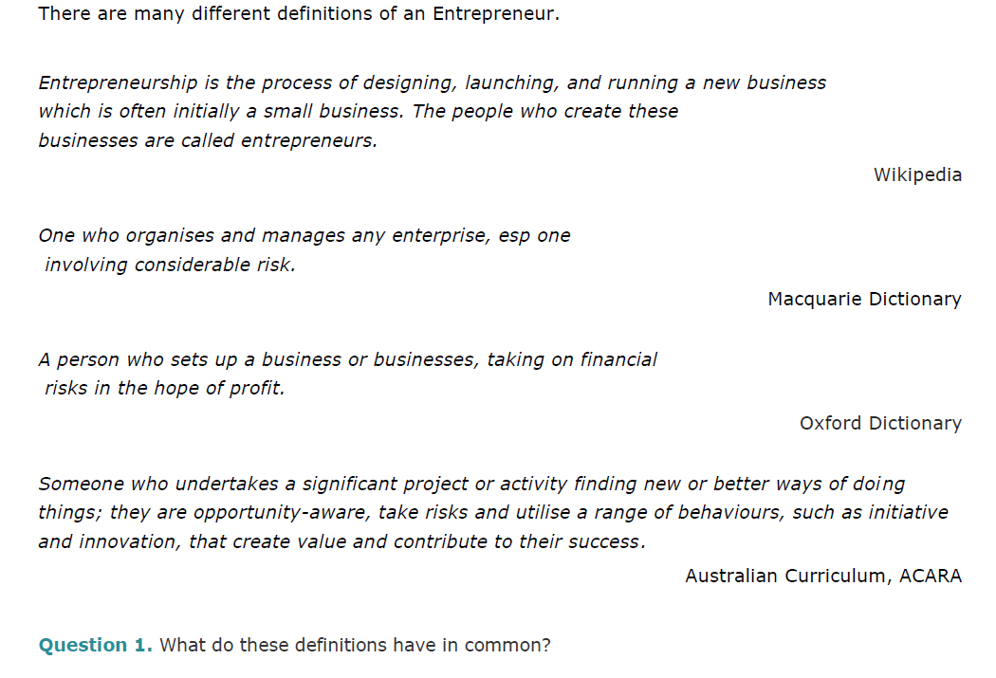
WHAT IS ENTREPRENEURSHIP?

Slide 7
Risk takers
Resilience (bounce back)
Passionate
Characteristics of an Entrepreneur
Understanding of finances
Organised
Strong work ethic
Innovative

Slide 9
TEENAGE MILLIONAIRES- SUNDAY NIGHT
https://www.youtube.com/watch?v=1YCGM7FiCGg
Choose one of the entrepreneurs from the video.
What challenges did they need to overcome?
List 3 characteristics that they have.
Why do you think they were able to be so successful?
Do you think you could be an entrepreneur? Why/why not?

Slide 10
INNOVATION
The act of creating or starting something new and different.
Innovators improve on an existing idea or create something from scratch
Innovative businesses are always trying to stay ahead of their competition (e.g. Apple and Samsung)
Can benefit society- many innovators are motivated by their desire to help people

Slide 11
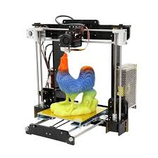
3D PRINTERS
How could 3D printer technology create business opportunities?

Slide 12
DIFFERENCE BETWEEN AN INNOVATOR AND AN ENTREPRENEUR
Innovation is applying your creativity to come up with a unique idea or solution. It is technological invention, which lets parts do what they could not previously do. You have an engine, wheels and axles and you put them together to invent a car. Progress depends on innovation and great innovators can get rich.
Entrepreneurship, by contrast, is applying the innovation to bring the ideas to life. It is social invention, which lets people do what they could not previously do. Entrepreneurs grasp the opportunity to cash in on the innovation. They build businesses and propel the innovation forward. Progress depends on entrepreneurship and great entrepreneurs get even richer than great innovators.

Slide 13
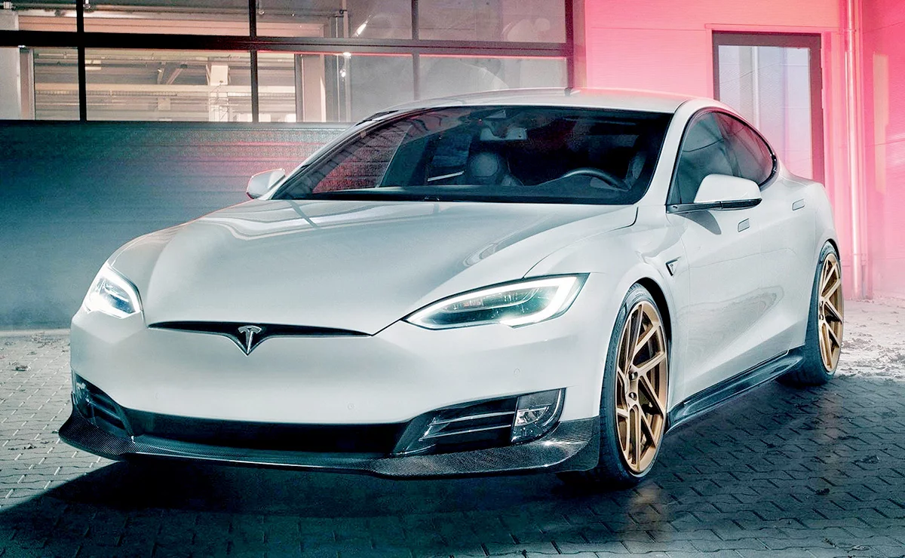
ELON MUSK
https://www.youtube.com/watch?v=UPM2z3NkMsQ

Slide 14
ELON MUSK
https://www.youtube.com/watch?v=k9zTr2MAFRg
South African-born American entrepreneur and businessman who founded X.com in 1999 (which later became PayPal), SpaceX in 2002 and Tesla Motors in 2003.
He became a multimillionaire in his late 20s when he sold his start-up company, Zip2, to a division of Compaq Computers.
Musk made headlines in May 2012, when SpaceX launched a rocket that would send the first commercial vehicle to the International Space Station. He bolstered his portfolio with the purchase of SolarCity in 2016, and cemented his standing as a leader of industry by taking on an advisory role in the early days of President Donald Trump's administration.

Slide 15
ELON MUSK
What was the issue/problem that Elon Musk identified?
What was the creative solution to the problem?
Who benefits from this?
How did they start their business?
Where are they located?
What characteristics does he have?

Slide 16
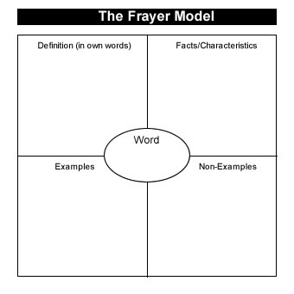
FRAYER MODEL

